Slide 1

SVHC and authorisation from a Swedish perspective
Seminar on Industry Obligations
Belgrade 11 December 2014
Eva Sandberg
International Unit
Swedish Chemicals Agency

Slide 2
Outline
REACH –authorisation and SVHCs, important points - Risk Management Options
Swedish enforcement
PRIO – a Tool for Risk Reduction of Chemicals
Chem Sec – SIN list and Subsport
Notes:
First a little reminder/rehearsel

Slide 3

REACH: Key elements
Registration of chemicals
Evaluation of some registered chemicals
Authorisation of (some) Chemicals
Restriction of (some) Chemicals
Notes:
I will only talk about the most interesting parts that I think is most interesting and useful from your perspective. If you want to have more details you can always ask me later.

Slide 4
REACH – Authorisation
Scope: substances of very high concern (SVHC)
  CMR 1 A and B, PBT, vPvB, ‘scientific evidence of probable serious effects’
Substance cannot be used (including imported) unless authorised for specific uses and if
  risks are adequately controlled
  and/or socio-economic benefits outweigh risk
Prioritised - Substances progressively authorised (as resources allow)
Ultimate objective: substitute SVHC by less hazardous substances or technologies
Notes:
Some substances have so severe inherent properties and considered so dangerous that they can only be used for specific uses and after an authorisation for that use is granted.
Risks can not be adequately controlled for :
CMR and substances of equivalent concern for which it is not possible to established an effect threshold.
PBTs and vPvBs.
Commission decision, on the basis of an opinion from the Agency
1: Identification of Substances of very high concern
2: Inclusion in Candidate list
3: Draft Recommendation on Priority substances for authorisation
4: Commenting period (3 months)
5: ECHA Recommendation to Commission
6: Commission decision = inclusion in Annex XIV
- application date
- sunset date (≥18 months later)
First application period ongoing

Slide 5
Authorisation - steps
1: Identification of Substances of very high concern (SVHC)
- comments invited
2: Inclusion in Candidate list
3: Draft Recommendation on Priority substances for authorisation
- comments invited
4: ECHA Recommendation to Commission
5: Commission decision = inclusion in Annex XIV
- application date
- sunset date (≥18 months later)
First applications are currently considered
Notes:
Before/After Each Step a Publication is made on ECHA website
Comments invited
Proposals for identification as a SVHC – 45 days
Draft recommendation for authorisation – 3 months

Slide 6
Information obligations – Candidate list
From the date of inclusion on the Candidate list of a SVHC, any supplier of an article which contains substances on the Candidate List in a concentration above 0.1% (w/w) has to provide sufficient information, available to the supplier,
    to the recipients (professional and industrial users, distributors) and
    on request, to a consumer - free of charge - within 45 days of the receipt of the request
  This information must ensure safe use of the article including as a minimum the name of the substance
Currently 155 substances on the Candidate list

Slide 7
Further Obligations
Substances on their own
    Safety data sheet from date of inclusion
Substances in mixtures
  Safety data sheet at recipients request and from date of inclusion if at least one CL substance ≥ 0,1%
Substances in Articles
  Normal registration applies to substances in articles that are intentionally released from the article
  Notification by manufacturer/importer to ECHA of unregistered uses of Candidate List substances within 6 months of inclusion in the Candidate list
Notes:
Producers and importers of articles have a legal obligation to notify Candidate list substances in their articles (e.g furniture, clothes, vehicles, toys)
Companies shall notify to ECHA within 6 months of the inclusion of the substance on the candidate list.
The first deadline was 1 June 2011
New information on SVHC’s in articles may reveal uses which may require further risk management action.

Slide 8
Restrictions
May be applied to:
  manufacture, use and placing on the market
  a substance on its own, in a preparation or in an article
When:
  an unacceptable risk to human health or the environment
  the risk needs to be addressed on a Community-wide basis
Restrictions will be included in Annex XVII
  takes over existing restrictions of Directive 76/769/EC
Notes:
As said ECHAs website contains a lot of useful information.
SVHCs and candidate list as well as proposals for restrictions and accepted ones give you an indication of what the EU are concerned of and a lot of background information. Could serve as an incentive to look at the situation, production and/or use in your country.

Slide 9
Substances of Potential Concern
Which road to take?
Authorisation or restriction?
  2 different risk Management Options (RMO) in REACH
  Other options within or outside REACH

Slide 10
The roadmap on Substances of Very High Concern for 2020 - 1
2010 EC committed to have 136 Substances of Very High Concern (SVHCs) on REACH candidate list by end of 2012.
For the long term, EC agreed to have all currently known SVHCs included in the candidate list by 2020.
Sets out how to identify these substances
Based on Risk management Options
  Authorisation, restriction or substance evaluation or legislation outside REACH
Notes:
In 2010, Vice-President Tajani and Commissioner Potočnik committed to have 136 Substances of Very High Concern (SVHCs) on REACH candidate list by end of 2012. this commitment was met in December 2012 and 138 SVHCs
Considering the long term, Vice President Tajani and Commissioner Potočnik have agreed to have all currently known SVHCs included in the candidate list by 2020. This second commitment means that by 2020, we will need to analyse the information on a large number of substances, not only to determine the relevance of SVHCs that are known today, but also to identify new potential SVHCs that will come out of REACH registration and evaluation
The Roadmap describes how to examine the substances that may belong to one of the above categories, by giving priority to those that have been registered and are not used only as chemical intermediate. Potential SVHCs excluded by this selection could still be considered after 2020. The Roadmap aims to improve planning, predictability, communication and to define responsibilities and deliverables.
The Roadmap is based on the Risk Management Options (RMO) approach. Consistent with the principles of better regulation, the RMO identifies the best regulatory option to manage the risk, either in REACH (authorisation, restriction or substance evaluation) or outside of REACH (with another legislation).

Slide 11
The roadmap on Substances of Very High Concern for 2020 - 2
Defining the Roadmap, it is fundamental to remind that the aim of the authorisation process, assuring that the risks from SVHCs are properly controlled and progressively replaced by suitable alternatives.
No numerical goal is identified
From 2010 to 2012, RMOs for around 160 substances have been prepared and shared between MSCAs, Commission and ECHA.
Work has started for the identification of SVHCs falling under Article 57(f) of REACH ("substances of equivalent concern" to CMRs and PBTs), focusing on sensitizers and endocrine disruptors.
  This work will lead, in the future, to the identification of less known and less regulated SVHCs.
Notes:
Defining the Roadmap, it is fundamental to remind that the aim of the authorisation process, assuring that the risks from SVHCs are properly controlled progressively replaced by suitable alternative substances or technologies where these are economically and technically viable".
The Commission considers that no numerical goal should be identified in the Roadmap for the number of substances that will be included in the candidate list, as it cannot be pre-judged how many or which substances will be identified as relevant SVHCs. Rather, the Roadmap should focus on presenting a credible process to ensure the 2020 objective
From 2010 to 2012, RMOs for around 160 substances have been prepared and shared between MSCAs5, Commission and ECHA.
Work has started for the identification of SVHCs falling under Article 57(f) of REACH ("substances of equivalent concern" to CMRs and PBTs), focusing on sensitisers and endocrine disruptors. This work will lead, in the future, to the identification of less known and less regulated SVHCs.

Slide 12
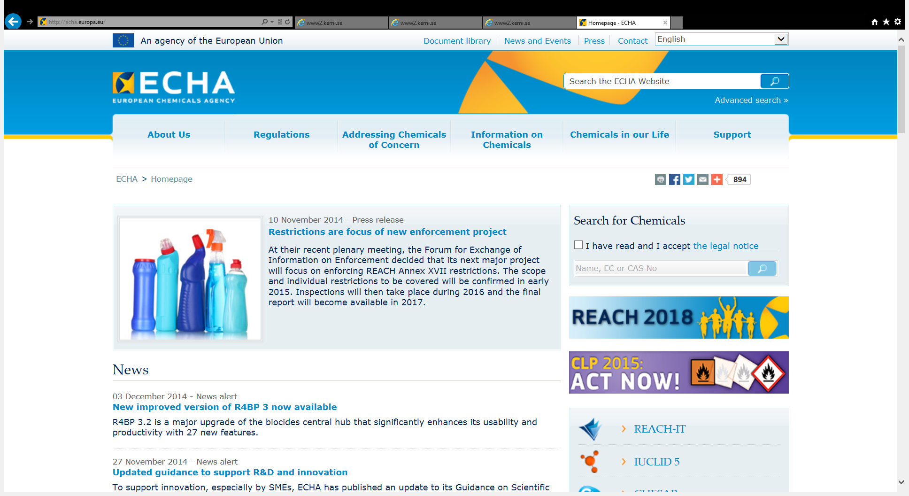
Notes:
You will find information on different steps on the ECHA website also very early in the process. Also which substances are discussed for RMOs

Slide 13
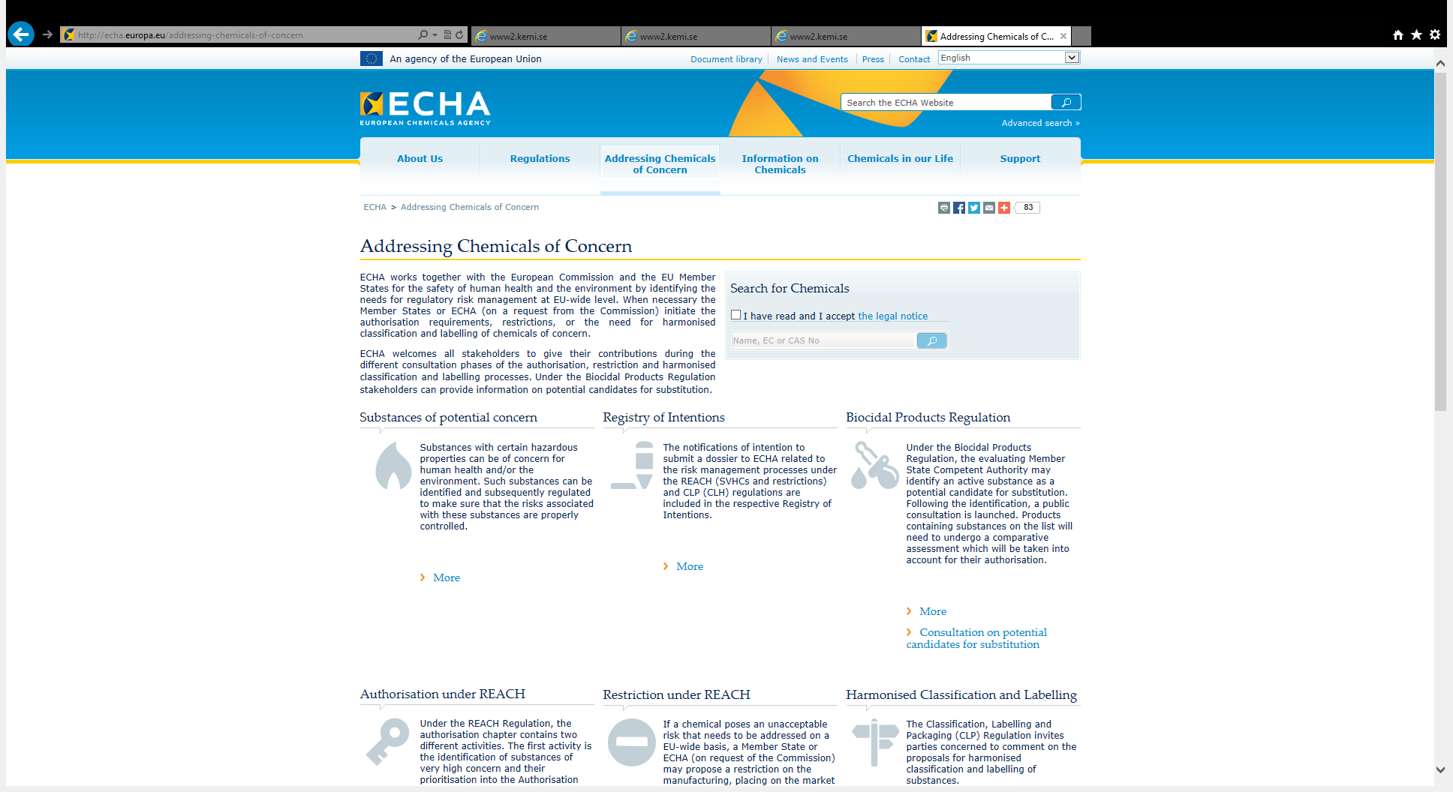

Slide 14
On the way to the Candidate list
Follow substances discussed for RMOA
Follow coming proposals to identify SVHCs on
  Registry of Intentions
Follow proposals on
  Submitted SVHC proposals
Currently 155 substances on the candidate list
  Updated twice a year
  Possibly around 20 more this week
Notes:
If you follow this on the ECHA website you will never be taken by surprise and you can start early to find alternative to the substances risking of being identified and subject to one or another legislation.

Slide 15
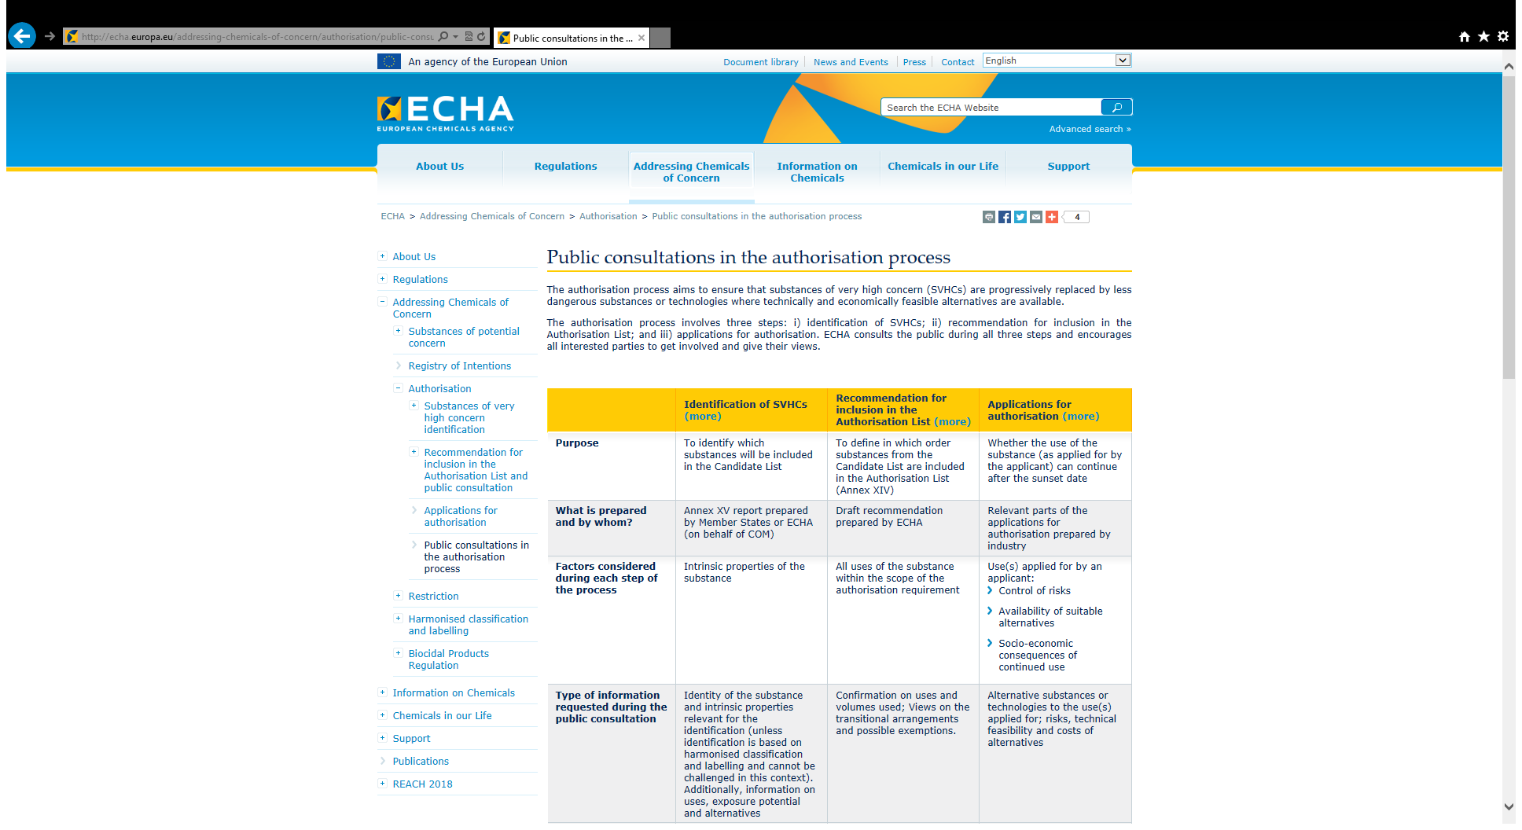

Slide 16
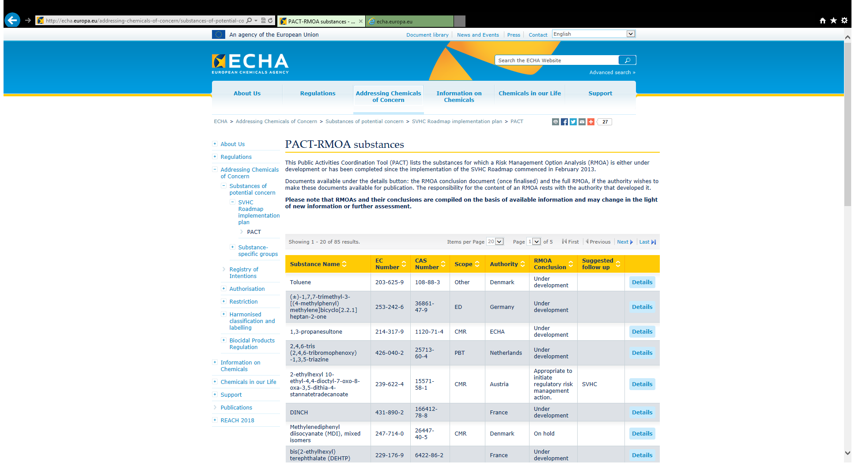
SVHC Roadmap to 2020 Implementation Plan
PACT
Notes:
This Public Activities Coordination Tool (PACT) lists the substances for which Risk management options analysis is either under development or has been completer since the implementation of the SVHC roadmap started in Feb 2013. The full RMOA is only available if the responsible CA so considers it is OK.
Updated this week with 13 more substances

Slide 17
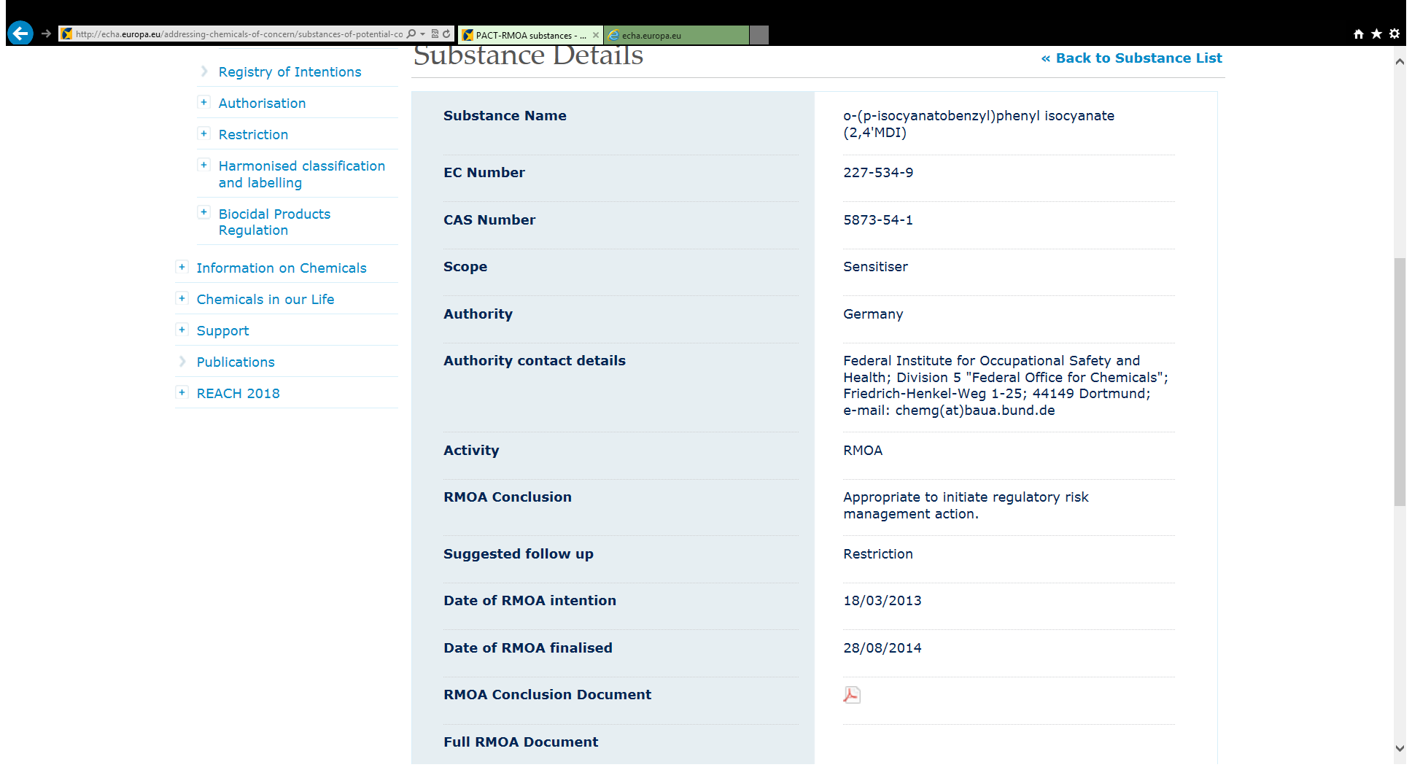

Slide 18
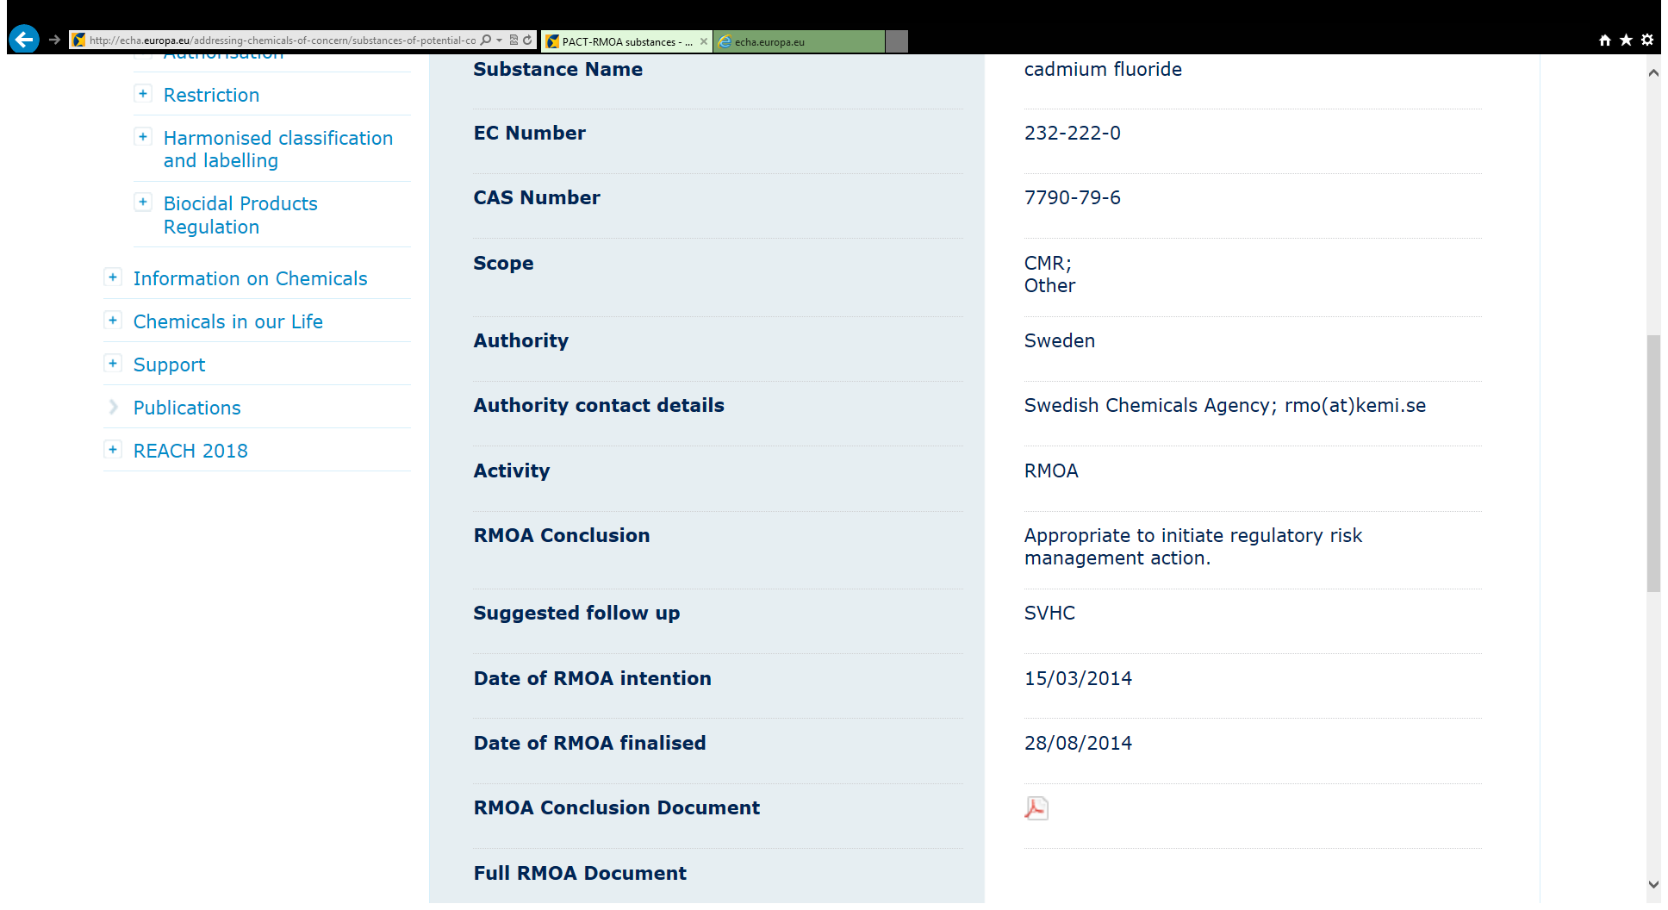

Slide 19
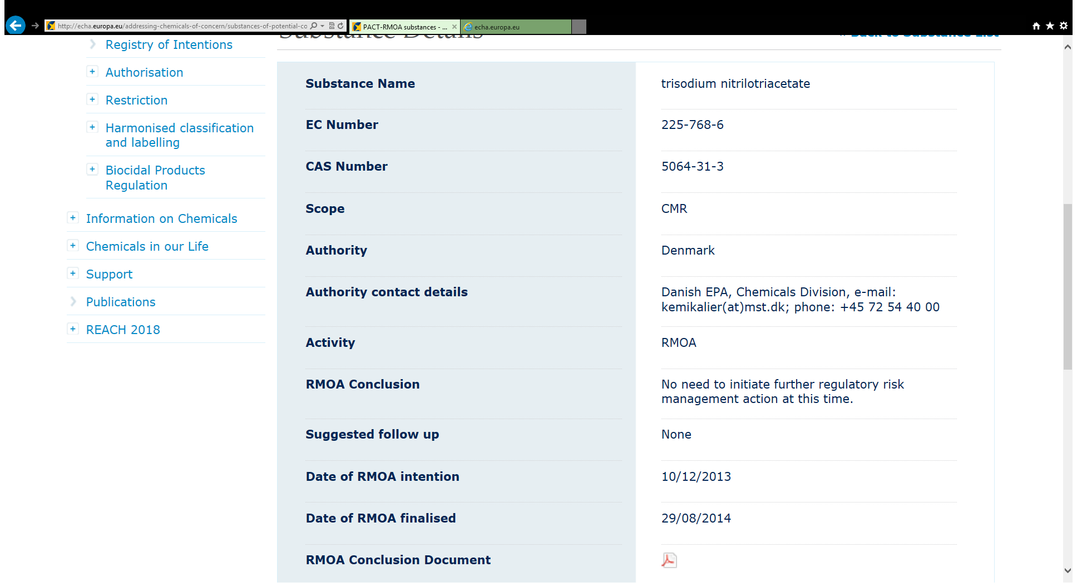

Slide 20
Further information
More information about REACH and CLP, how it works and available tools can be found on the website of the European Chemicals Agency in the Classification section at:
http://echa.europa.eu/classification_en.asp

Slide 21
Outline
REACH –authorisation and SVHCs, important points - Risk Management Options
Swedish enforcement
PRIO – a Tool for Risk Reduction of Chemicals
Chem Sec – SIN list and Subsport

Slide 22
Enforcement
National responsibility under all Union legislation
Swedish strategy each year
Regional and local authorities involved as well
Cooperates with rest of EU via Forum for the Exchange of Information on Enforcement
  Next Forum project focuses on Restrictions
  Information on ECHA website
Notes:
Including penalties

Slide 23

Strategy for effective enforcement
Criteria for prioritising groups of articles
  risk to human health or the environment
  probability of finding a dangerous substance in the article
  possible to enforce
Prioritised groups of articles
  clothing, shoes and accessories
  toys and other articles intended for children,
  electrical and electronic equipment,
  building products and furnishing etc.
Targeting economic actors
  Cooperation with Customs, import statistics, structural business statistics, general internet searches, RAPEX, ICSMS, other market surveillance authorities, other authorities in the EU…
Notes:
Lack of regulations for some articles, a lot in others.

Slide 24

Experiences
Inspections and chemical analyses necessary - but demanding in resources
  Having results of an analysis of an article from the actor makes an on-site inspection more effective!
  Face-to-face inspections bring us more understanding of the business segment/business environment
Focussing on a few business segments at a time gives us
  A better understanding of the business segment/article group
  Better impact in the business segment
Generally low awareness of chemical legislation/risks among economic actors – With many exceptions!

Slide 25
Number of inspections and analysed articles
Inspection of jewellery etc with municipalities

Slide 26
KemI:s enforcement of articles in 2008-2013
Group of articles | Number of articles analysed | Percentage non-compliant* | Common causes for non-compliance
Toys | 640 | 16 % | Phthalates, SCCP, Pb in electric
Childcare | 52 | 4 % | Phthalates
Clothing, shoes, accessories | 300 | 5 % | Azo-dyes, Pb, Cd
Flooring | 44 | 0 % | -
Furniture | 74 | 0 % | -
Oil lamps | 11 | 100 % | design
Home electronics | 330 | 13 % | Pb, brominated flame retardants
Other | 130 | 7 % | SCCP, Cd
* does not include when duty to inform was not fulfilled
Notes:
Lack of regulations in some areas!

Slide 27
Penalties
Article in REACH | Infringement | Penalty
5,6, 7.1 or 7.5 6, 7.1, 7.5, 20.2, 22.1, 22.2, 40.4 12.2 or 22 | Manufacture or import – no registration Submits incorrect information in a registration or in a document which completes a registration Neglects to update the registration with new information | Fine or imprisonment for a maximum of two years. If the offence is serious, the penalty shall be a term of imprisonment of not less than six months or more than six years.
31 | Neglects to provide DU with a safety data sheet Incorrect or insufficient information in the safety data sheet | Fine or imprisonment for a maximum of two years. No penalty if not obstructing risk assessment of damage to Human Health and the Environment
33 | Neglects to provide information about a substance contained in an article which is included in the candidate list | Fine or imprisonment for a maximum of two years. No penalty if not obstructing risk assessment of damage to Human Health and the Environment
Notes:
REACH and penalty provisions
The REACH regulation is a European Community regulation and applies directly in EU member states and in the EES countries Norway, Iceland and Liechtenstein. However, penalty provisions for infringement of REACH are determined on a national level.
Sweden has national penalty provisions in the Environmental Code (1998:808), chapter 29. The supervisory authority shall report infringements of the provisions of this Code or rules issued in pursuance thereof to the police or public prosecution authorities where there are grounds for suspicion that an offence has been committed. According to the Environmental Code the sanctions for infringement of REACH are generally a fine or imprisonment for a maximum of two years.
To article 33
1 It is only allowed to start a public prosecution if it is necessary from a public point of view.
2 According to article 3.13 downstream user means any natural or legal person established within the Community who uses a substance, either on its own or in a preparation, in the course of his industrial or professional activities.

Slide 28
Penalties
Article in REACH | Infringement | Penalty
32, 34 or 36 | Neglects to communicate information down the supply chain or to keep information | Fine
37.4 and 39.1 | Neglects to prepare a chemicals safety report | Fine or imprisonment for a maximum of two years
38, 39.2 and 66.1 | Neglects to report information to ECHA (downstream user) | Fine or imprisonment for a maximum of two years
56 | Uses or places a substance on Annex XIV on the market without authorisation | Fine or imprisonment for a maximum of two years
67 | Infringes a restriction to produce, place on the market or use a substance as such or in a mixture or in an article | Fine or imprisonment for a maximum of two years
31.5 | Not supplying a safety data sheet in Swedish | Environmental sanction charge: 5000 SEK

Slide 29
Outline
REACH –authorisation and SVHCs, important points - Risk Management Options
Swedish enforcement
PRIO – a Tool for Risk Reduction of Chemicals
Chem Sec – SIN list and Subsport

Slide 30
PRIO - A Tool for Reduction of
Chemical Risks
A tool in line with the Swedish environmental goal
a Non Toxic Environment
Support companies / SME:s in the work with substitution
Target groups: env.managers, product developers, purchasers
Support for companies to prepare for REACH
Based on the Swedish Environmental Code
- chemical legislation

Slide 31
Chemical substances are selected on the basis of criteria for hazardous properties two levels – two consequences
Phase-out substances
- substances of particular concern, requires that the use of particularly hazardous substances shall cease to the extent possible.
Priority risk-reduction substances
- substances with hazardous properties, assess risk for intended use, consider substitution

Slide 32
Phase-out substances
CMR - carcinogenic, mutagenic or toxic to reproduction categories 1 and 2 (1A and 1B, CLP)
PBT/vPvB - persistent, bioaccumulating and toxic/very persistent and very bioaccumulating
Particularly hazardous metals - mercury, cadmium, lead and their compounds
Endocrine disruptive
Ozone-depleting
Notes:
We include Candidate list for this as well

Slide 33
Priority risk-reduction substances
Very high acute toxicity
Allergenic
Mutagenic - Category 3 (Cat 2, CLP)
High chronic toxicity
Environmentally hazardous, long-term effects
Potential PBT/vPvB

Slide 34
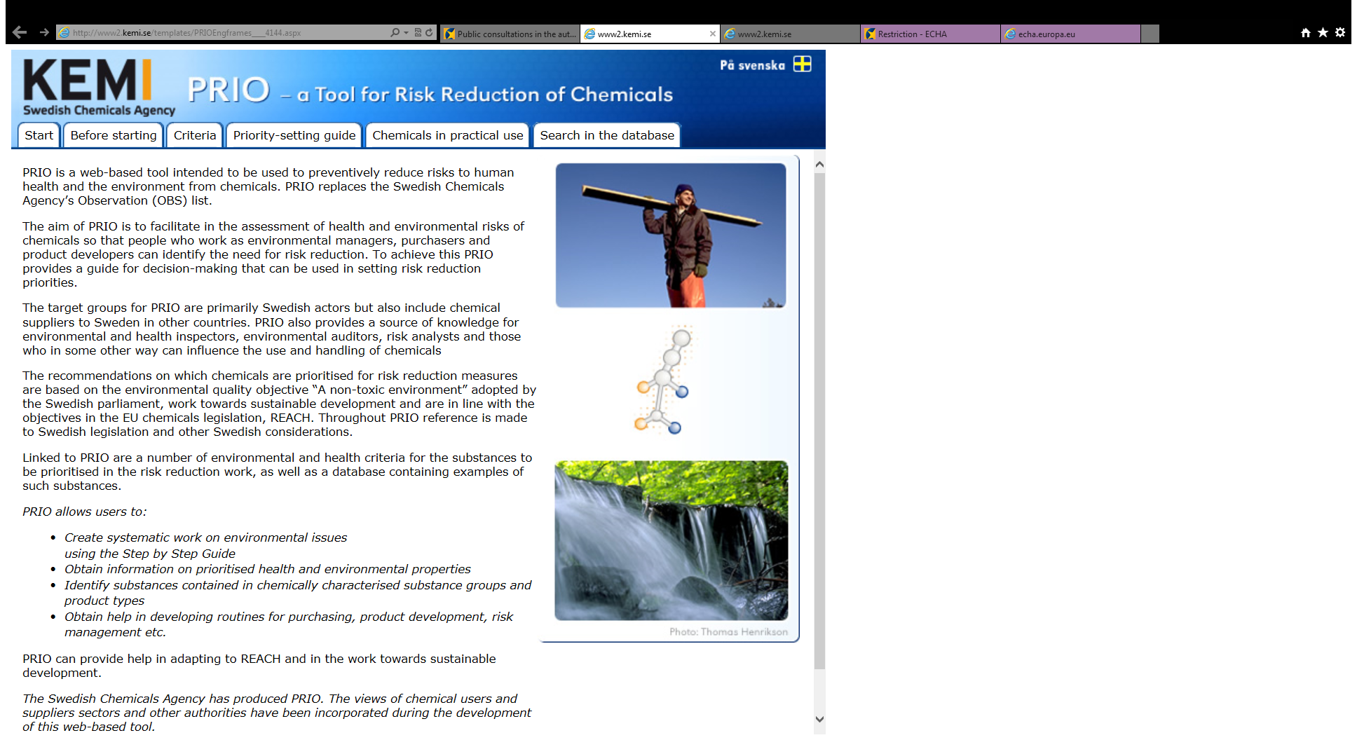
What is PRIO?
A guide and a database for informed decision making
A help to prioritise
A set of criteria (prioritised hazardous properties)
A database with more than 4600 substances
IT IS NOT A BLACK LIST!

Slide 35
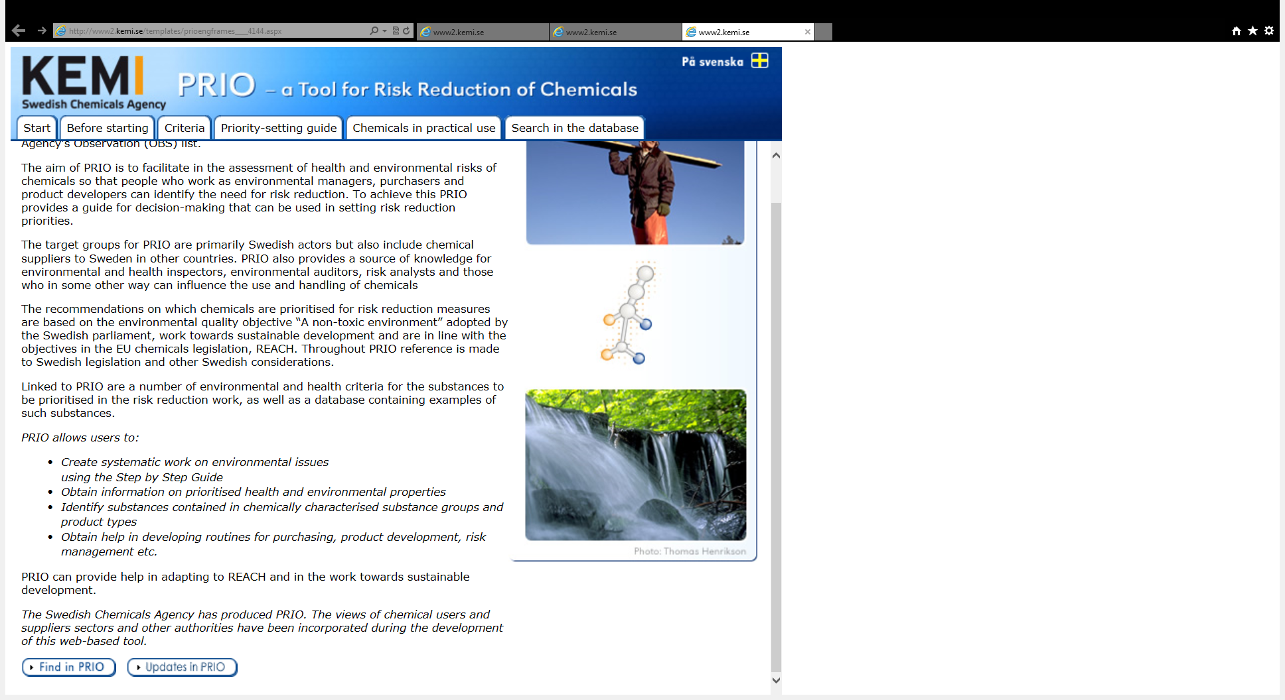

Slide 36
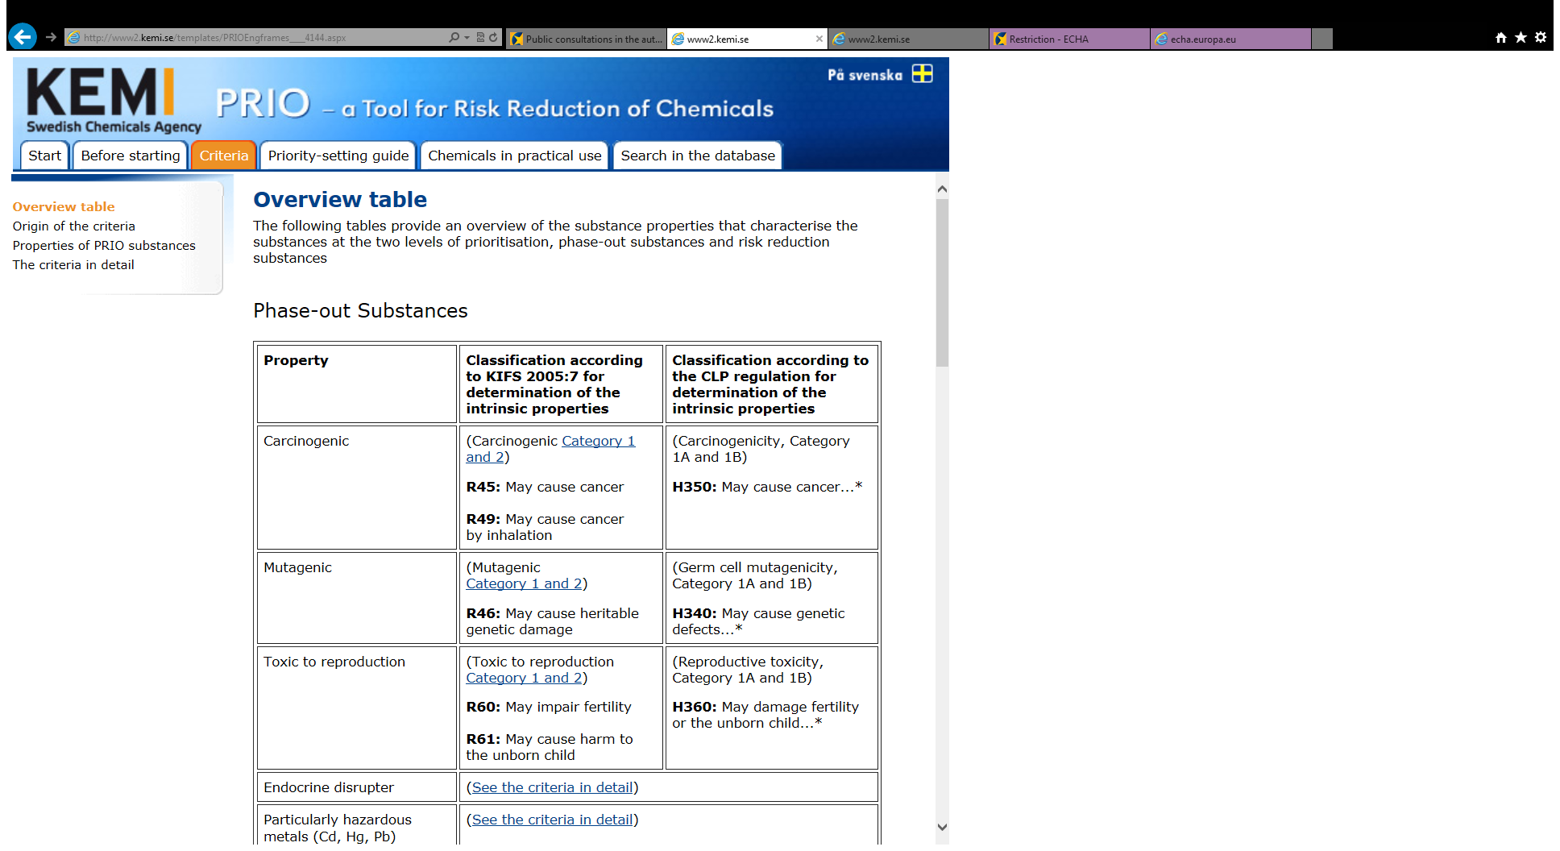

Slide 37
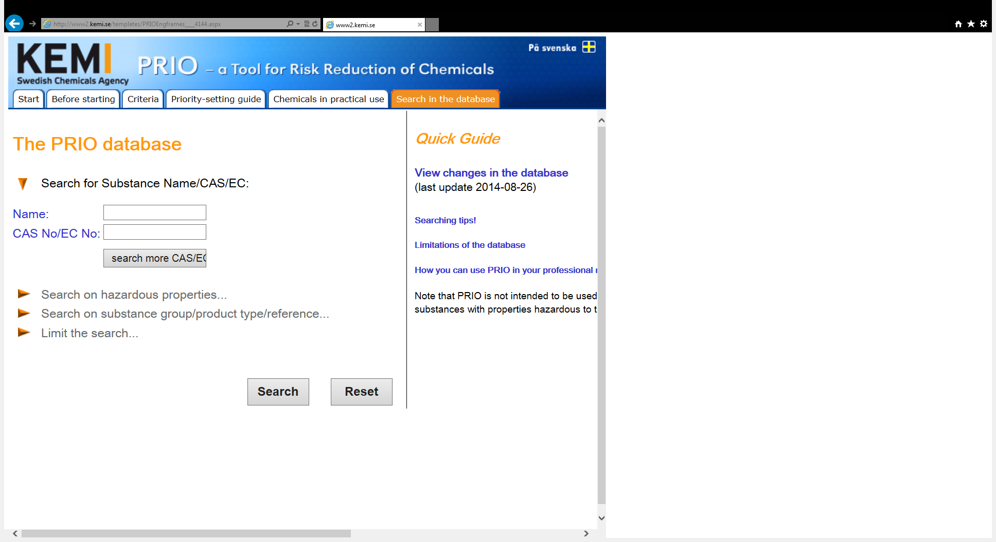
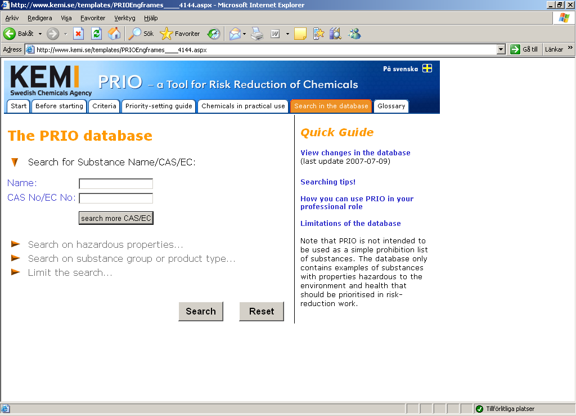
The database
More than 4600 substances
Transparency

Slide 38
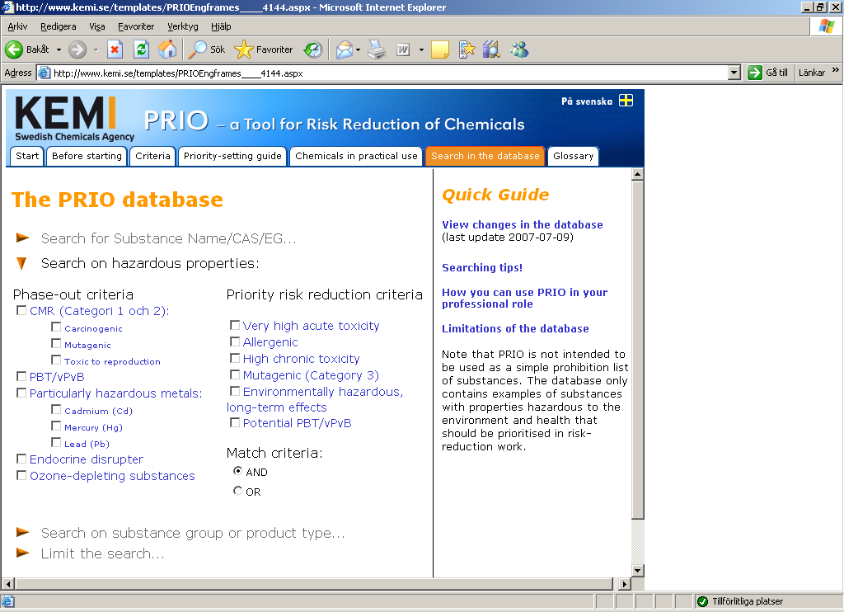
The database
Two set of criteria with different messages for action
You can search on
CAS/EG-nr
Name
Hazard
Substance group
(product type)
Source

Slide 39
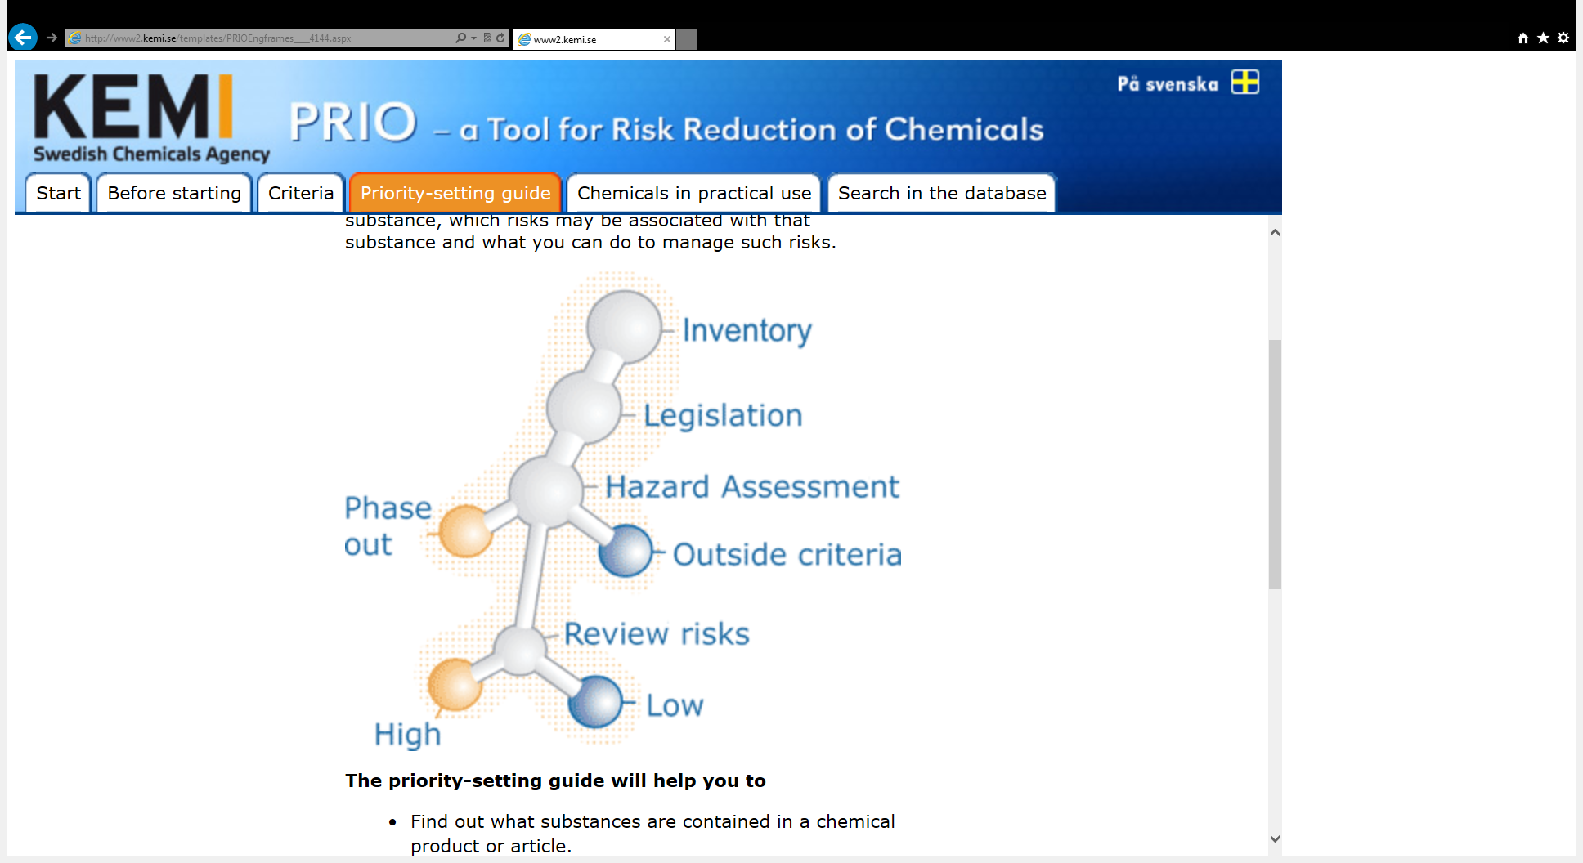

Slide 40
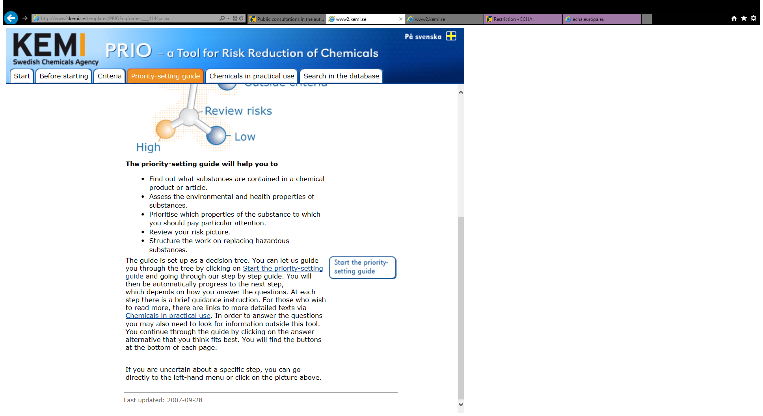

Slide 41
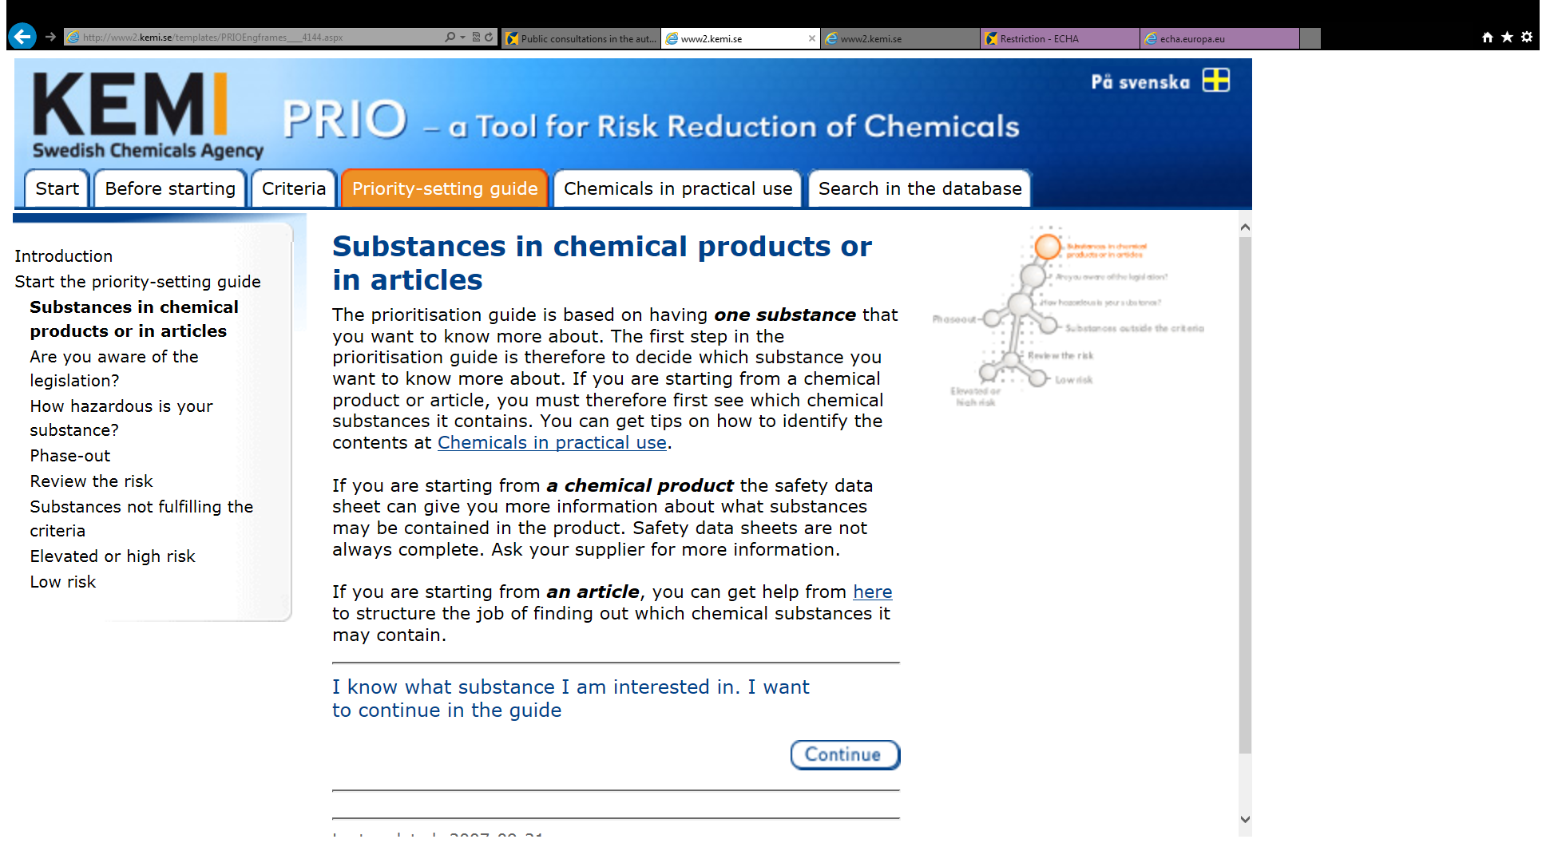

Slide 42
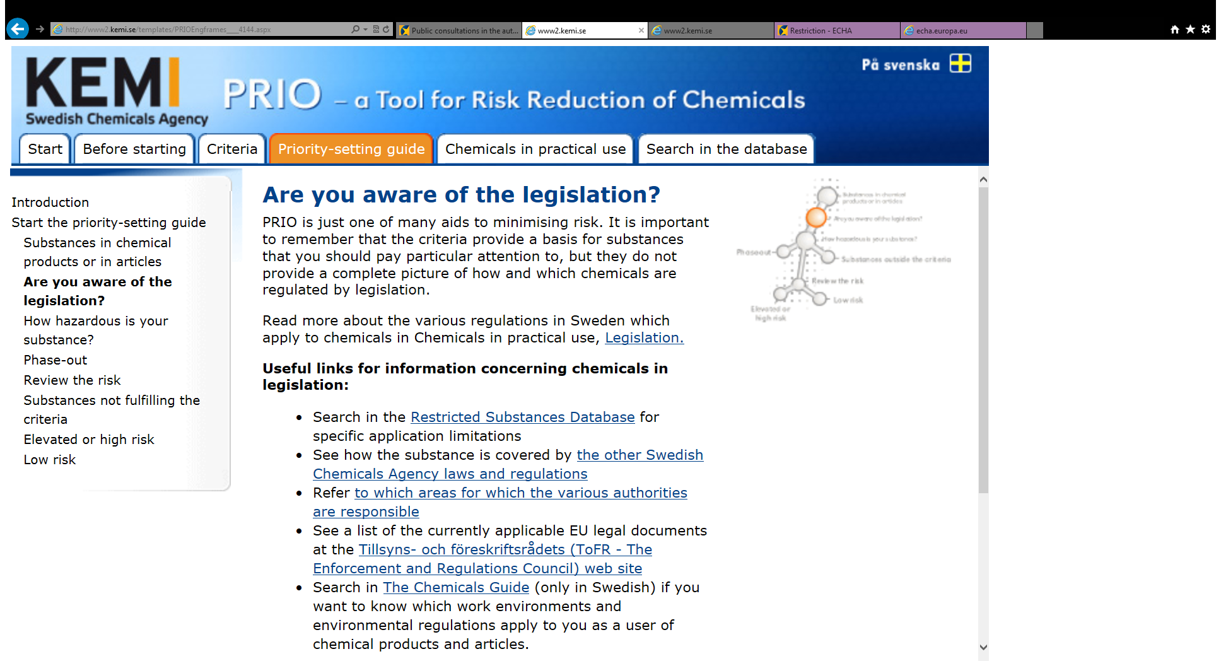

Slide 43
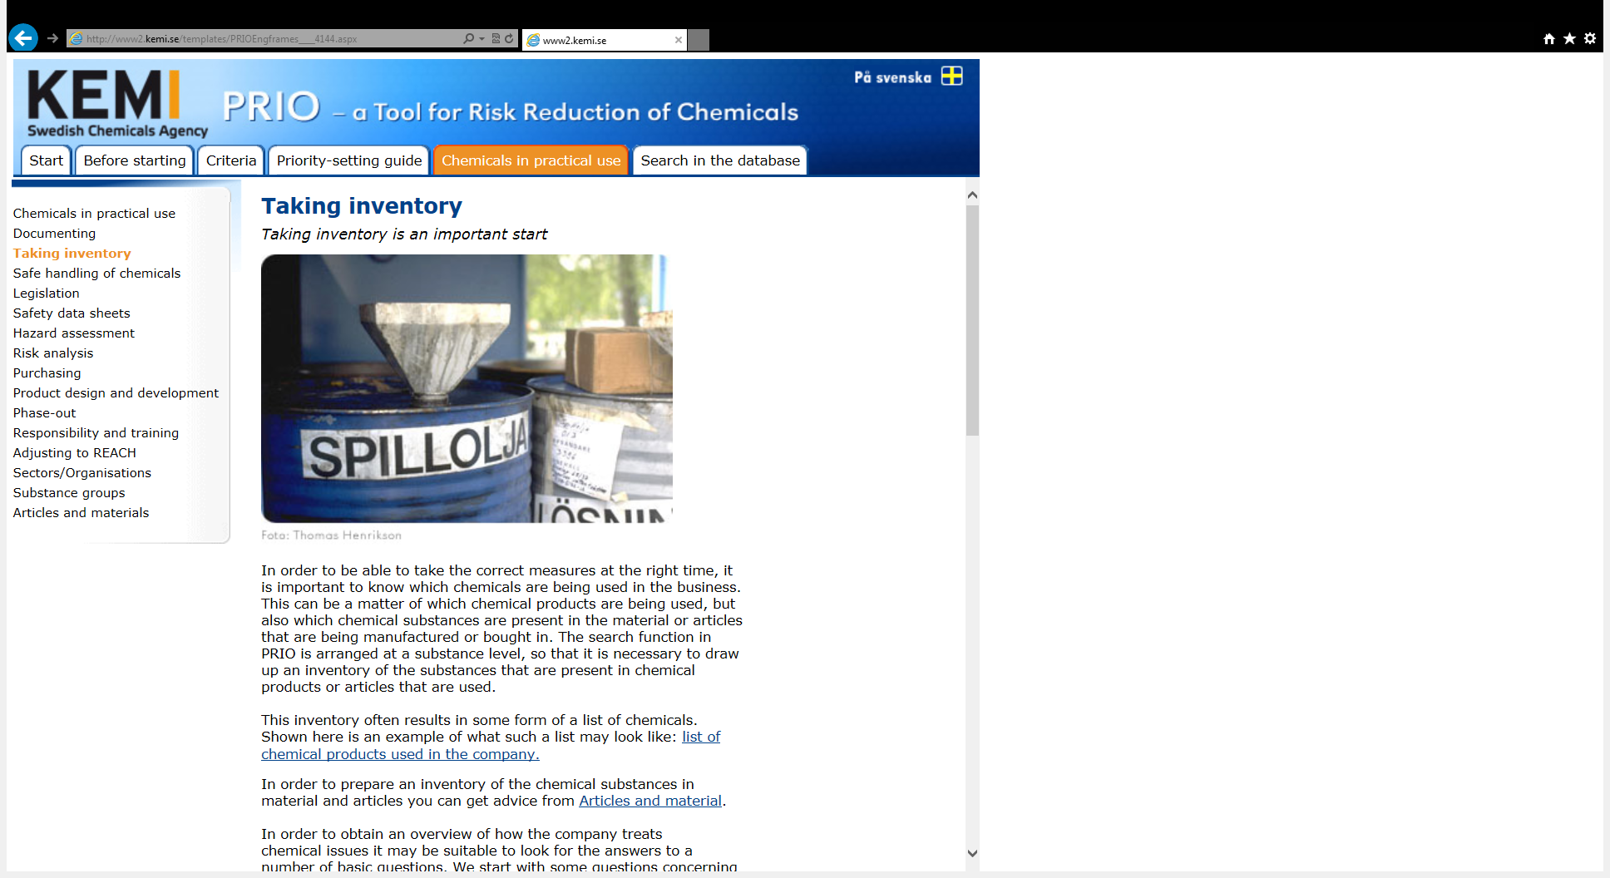

Slide 44
Seven steps to substitution
Why should the substance be replaced?
How can the function be fulfilled?
Assess alternatives
Risk assessment of alternatives
Which alternatives should we proceed with?
Planning
Evaluate and compare to step one
Notes:
When developing PRIO we worked a lot with understanding and the defining the target groups This part of PRIO aims at presenting the message in PRIO do different target groups.
Our main question is this work was who in society can act as a driving force for precaution and what do they need to know to use PRIO and to practise precaution.
In the guide part we turn to different actors that we believe can make a difference when it comes to decision making. It explains the context of PRIO and how it can be used for different functions with in a company such as product development, purchaser etc.
We also try to adapt the message to different stakeholders all from environmental auditors, local authorities, finance, ecolabllling organisations, recovery industry.

Slide 45
Problem with fire
Developed flame retardent
Design away from heat
Design close to heat
Notes:
Think outside the box!

Slide 46
Conclusions
PRIO is developed in cooperation with industry
to meet needs identified by the industry
The tool is now broadly used, also from countries abroad
There is an increasing interest to use PRIO in preparation for Reach
Agencies need information from industry and
industry need to be updated from agencies

Slide 47
Outline
REACH –authorisation and SVHCs, important points - Risk Management Options
Swedish enforcement
PRIO – a Tool for Risk Reduction of Chemicals
Chem Sec – SIN list and Subsport

Slide 48
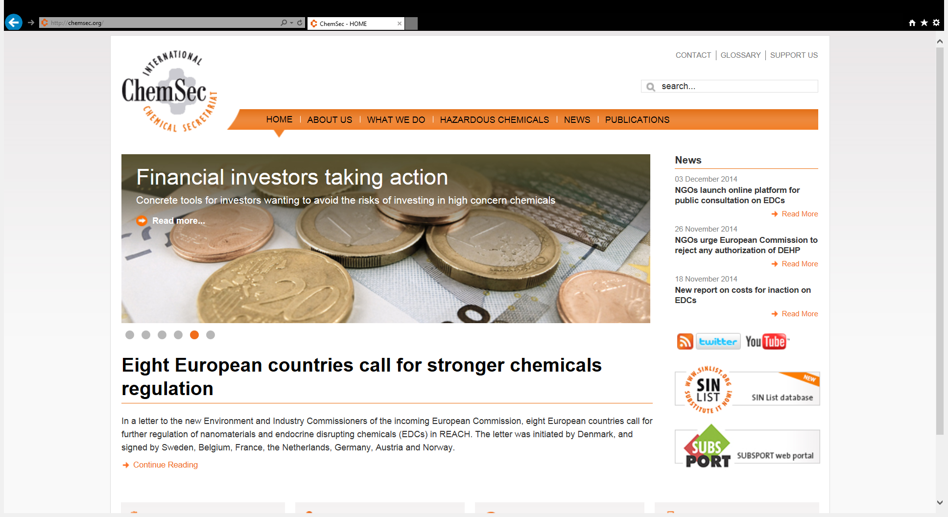
www.chemsec.org

Slide 49
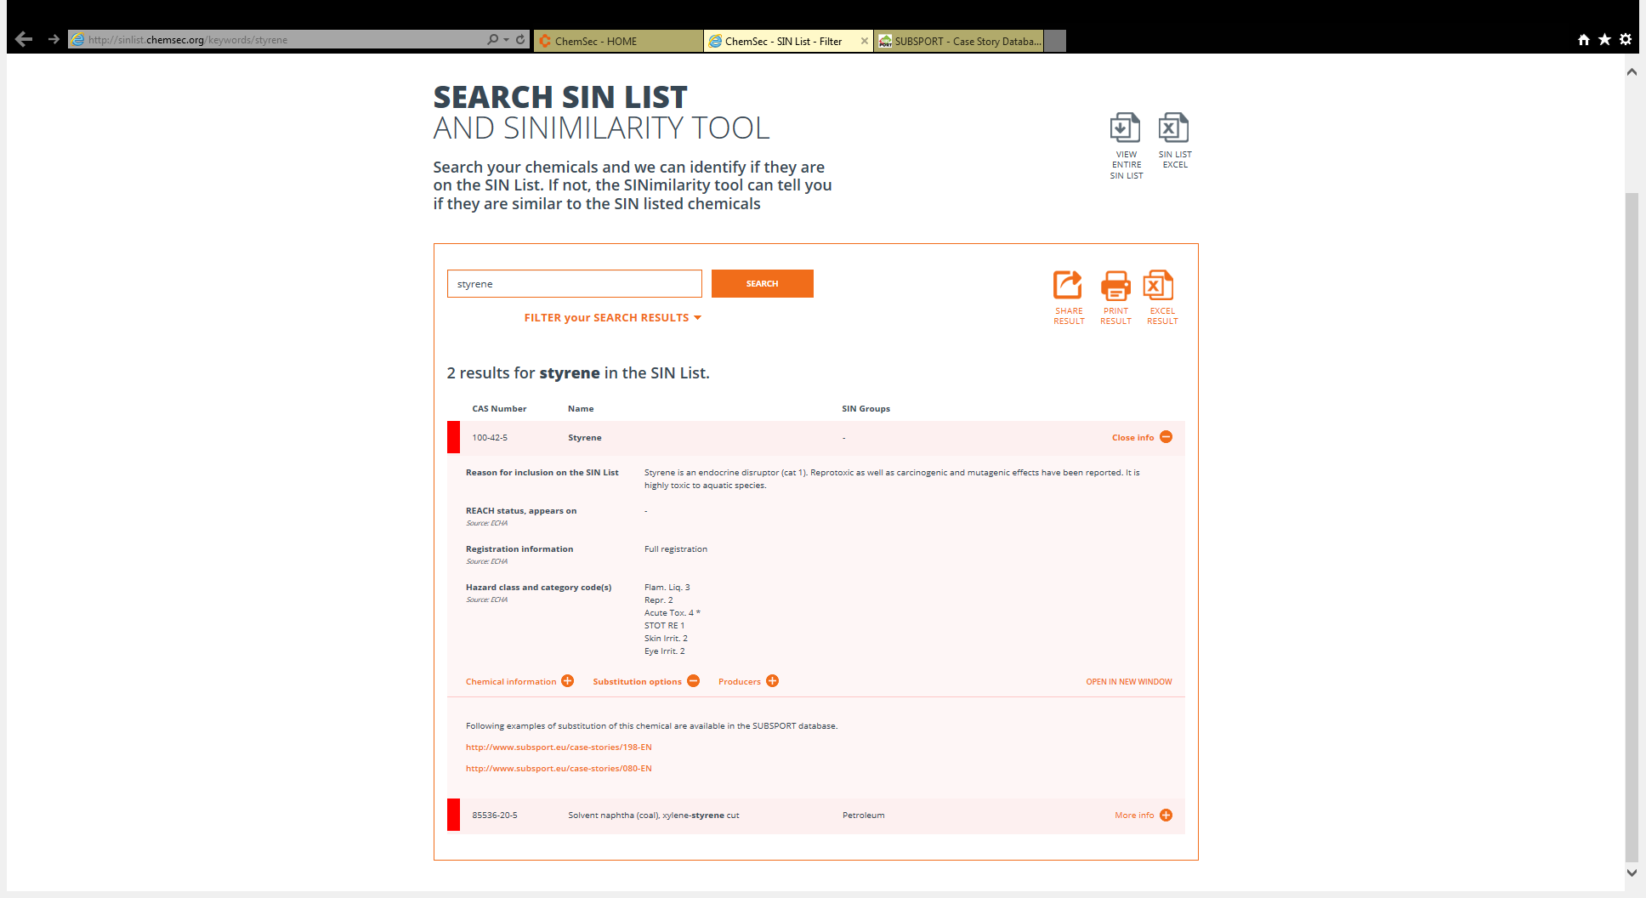

Slide 50
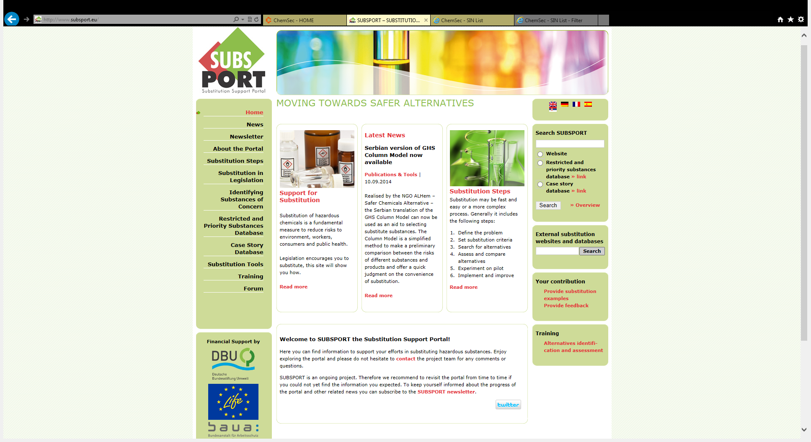

Slide 51
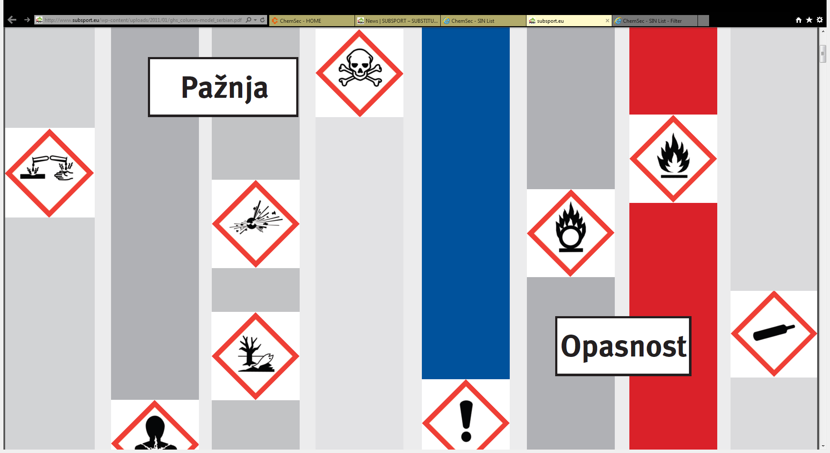
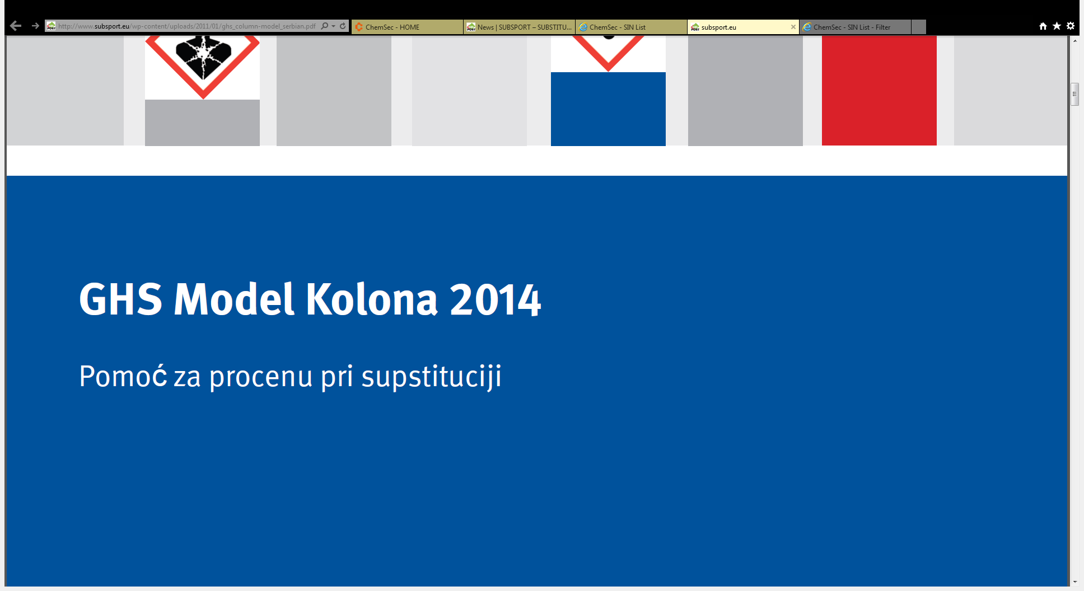

Slide 52
Thank you for the attention!
Questions?

